Slide 1
A Feature-Based of IT Automation using kaseya’s agent procedure called the wiping of unallocated disk space using cipher.exe
Developed By: Estuardo Fernandez
Advisor : Dr. S. Masoud Sadjadi School of Computing and Information Sciences Florida International University
efern005@fiu.edu
http://www.cs.fiu.edu/~sadjadi/

Slide 2
Agenda
Problem and Motivation
Solution
Behind the Scene
Customizing the Solution
Disclaimer
Progress Report

Slide 3
Problem:
When you delete files or folders, the data is not initially removed from the hard disk. Instead the space on the disk that was occupied by the deleted data is “deallocated” After it Is deallocated, the space is available for use when new data is written to the disk. Until the space is overwritten, you can recover the deleted data using a low-level disk editor or data-recovery software.

Slide 4
Motivation:
A company named Investigators “R” Us has it’s investigators use company laptops to write reports that contain confidential information gathered from interviews. The investigators are required to store their Microsoft word reports in an encrypted folder for 30 days and then delete the folder once the client has paid and is satisfied with the result of the report. It has been discovered that the encrypted files containing the deleted confidential reports were retrieved and published on the internet! The company has had to refund the client and has been embarrassed by their lack of security

Slide 5
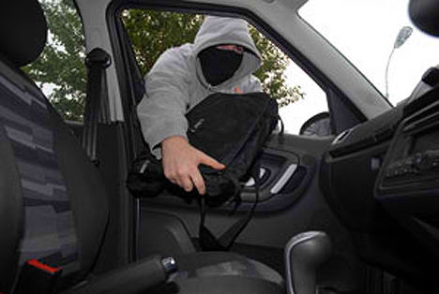
Motivation:
The company has had to refund the client and has been embarrassed by their lack of security. According to the company’s I.T. department, it is believed that the criminal’s used data recovery software to retrieve the information contained in the encrypted folder that was deleted from the recycle bin.

Slide 6
Solution:
To address this issue, the confidential data contained in the report needs to be wiped out of the hard drive completely. The company has come up with the solution of using kaseya’s services and running the agent procedure called “ the wiping of unallocated disk space”.

Slide 7
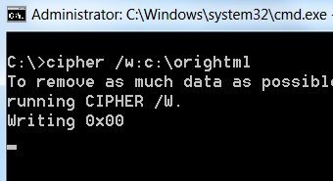
Behind the Scene
Kaseya uses the agent procedure called “ The Wiping of unallocated disk space” This procedure takes advantage of the Cipher.exe command. The Cipher.exe command is an external command that is available in windows 2000, XP, Vista and Windows 7 it alters the encryption of directories and files on NTFS partitions. There are many syntax switches that allow you to encrypt data, decrypt data and manage file/folder encryption. In this case we are using the /w syntax switch which removes data from available unused disk space on the entire volume.

Slide 8
Behind the Scene
The agent procedure called “ the Wiping of unallocated disk space” works by creating an if statement that is always returning as “true” so that it will always execute the two then statements. The 1st then statement creates a named procedure variable (local) named agenttempt, which is assigned the value retrieved by the managed machine that has the agent installed. The 2nd then statement executes the sell command. In this case it is typing Cipher/w:c:\>> #agenttemp#wipe.log.txt on the command line, which cause the Cipher command to start writing 1’s and 0’s on the C: that contained the confidential information.

Slide 9
Customizing the Solution
The solution will be customized by adding statements to the agent procedure to check if there if there are any users login into the system before the procedure is run. The agent procedure will ask the user’s permission before running the procedure. The user will receive a message box explaining what the procedure does and for the user to save their work.

Slide 10
Disclaimer
The shortcomings of this solution is that cipher.exe command only runs on the following windows platforms such as windows 2000, XP, Vista, Windows 7 and NTFS file systems. If the company decides to purchase Macintosh computers or Linux based computers another agent procedure would have to be created that runs a different command or program.

Slide 11
Progress Report
So far I have researched and read about using the Cipher command and it’s syntax. I have read the help files for the kaseya built in Agent procedure. I have created a fake confidential report and I have encrypted the folder that contains the file, I have deleted the file from the recycle bin. I have down loaded a recovery software to test bringing the encrypted folder back to life.
I still have to run tests on a virtual machine and run the agent procedure on the machine.

